Slide 1

Data Analyst Proficiency Insight: A Comprehensive Skills and Qualification Analysis
Thanapoom Phatthanaphan
Web Mining, Computer Science Department
Stevens Institute of Technology

Slide 2

Project Member
Thanapoom Phatthanphan
CWID 20011296
Degree Master’s Degree in Computer Science
Data Analyst Proficiency Insight: A Comprehensive Skills and Qualification Analysis

Slide 3
Overview
Dataset & Tools
Implementation
Results
Conclusion
Problem description
Nowadays, there’s a growing need for people who are good at data analysis. Many individuals are interested in starting a career in technology, specifically as a Data Analyst. However, this position involves learning various skills that makes it difficult for beginners to figure out which skills are most important for the Data Analyst role.
Research questions
What skills are most required for Data Analyst?
Which technical skills are most required for Data Analyst?
Which soft skills are most required for Data Analyst?
Which programming languages are most required for Data Analyst?
Which skills are good to have for more opportunities?
Data Analyst Proficiency Insight: A Comprehensive Skills and Qualification Analysis

Slide 4
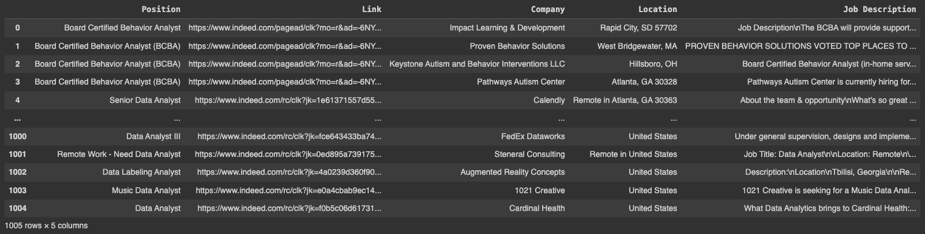
Overview
Dataset & Tools
Implementation
Results
Conclusion
Dataset
1,000 job descriptions of Data Analyst positions were collected by web scraping from the Indeed website.
1,005 job descriptions
Data Analyst Proficiency Insight: A Comprehensive Skills and Qualification Analysis

Slide 5










Overview
Dataset & Tools
Implementation
Results
Conclusion
Data handling
Plotting
Wordcloud
Web Scraping
Natural Language Processing tasks
Data Analyst Proficiency Insight: A Comprehensive Skills and Qualification Analysis

Slide 6
Overview
Dataset & Tools
Implementation
Results
Conclusion
Methodology
Data Collection
Data Preparation
Exploratory Data Analysis
Data Interpretation
Conclusion
Web Scraping Using BeautifulSoup and Selenium
Clean the dataset (Remove rows with missing value)
Tokentization (Remove stopwords, punctuation, and lemmatize words)
Extracted the tokenized job descriptions to unigram and bigrams
Define skills keywords to detect in job descriptions
Rule-based approach (Fuzzy Matching)
Word-embeddings approach (Matching with cosine similarity between vectors)
Visualize the number of required skills in graphical and numerical terms
Conclude the results
Data Analyst Proficiency Insight: A Comprehensive Skills and Qualification Analysis

Slide 7
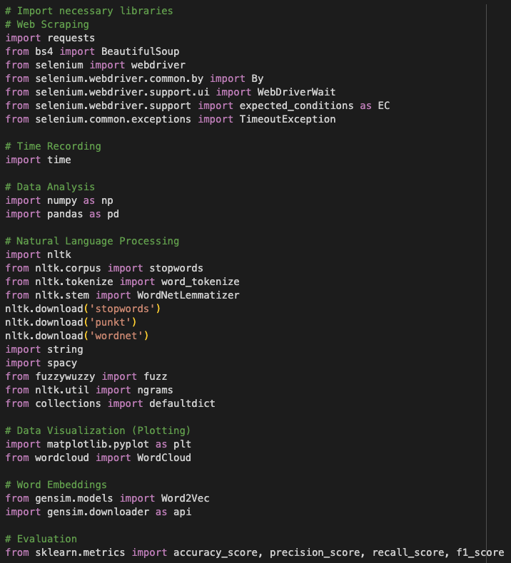
Overview
Dataset & Tools
Implementation
Results
Conclusion
Import the libraries
Web Scraping
Time recording
Data Analysis
Natural Language Processing
Data Visualization
Word Embedding
Evaluation
Data Analyst Proficiency Insight: A Comprehensive Skills and Qualification Analysis

Slide 8
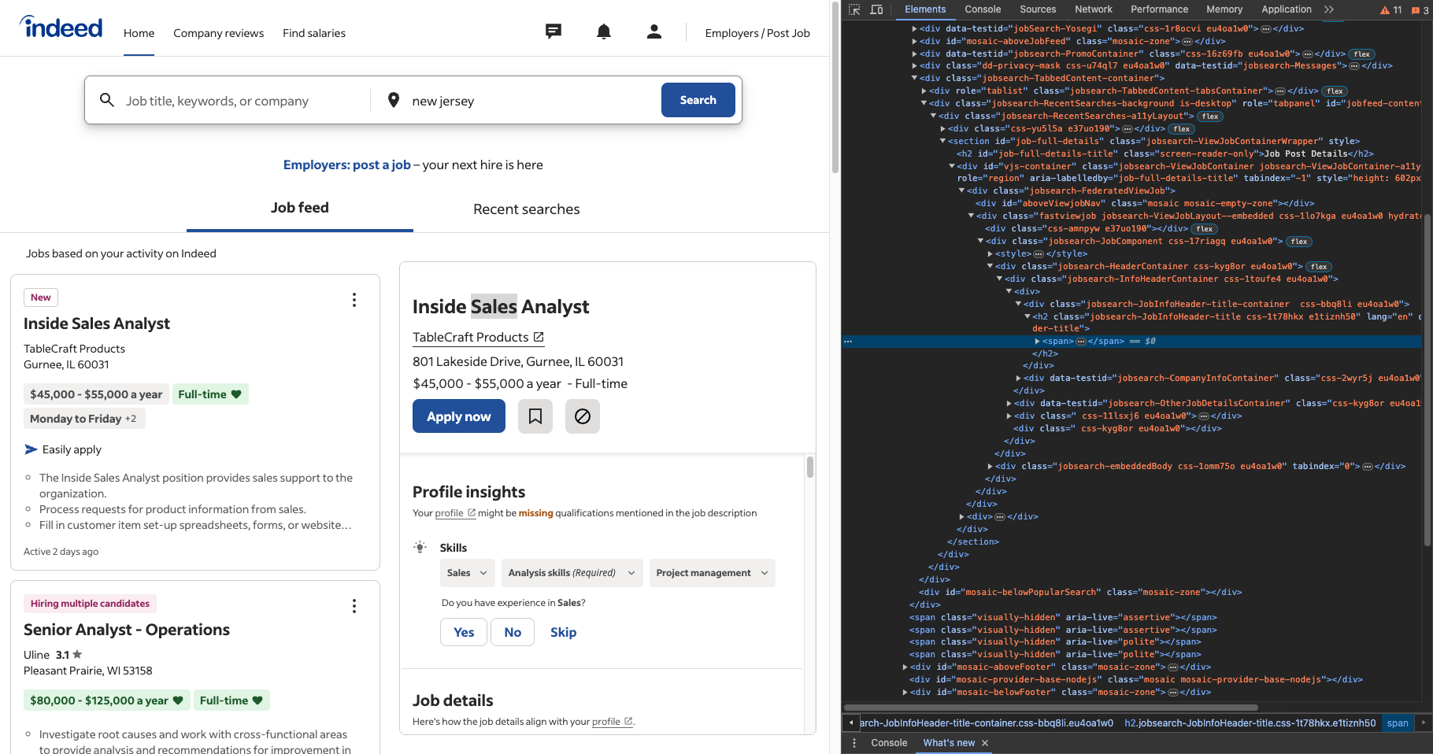
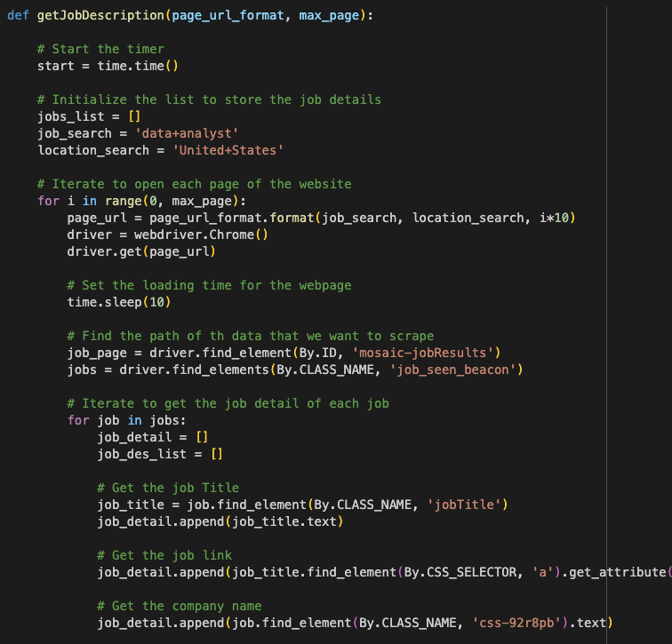
Overview
Dataset & Tools
Implementation
Results
Conclusion
1. Data Collection
Inspect the Indeed website to get ‘HTML’ for using in Coding
Dynamic scraping data
Coding using
BeautifulSoup & Selenium
Wait until the execution is done
Data Analyst Proficiency Insight: A Comprehensive Skills and Qualification Analysis

Slide 9
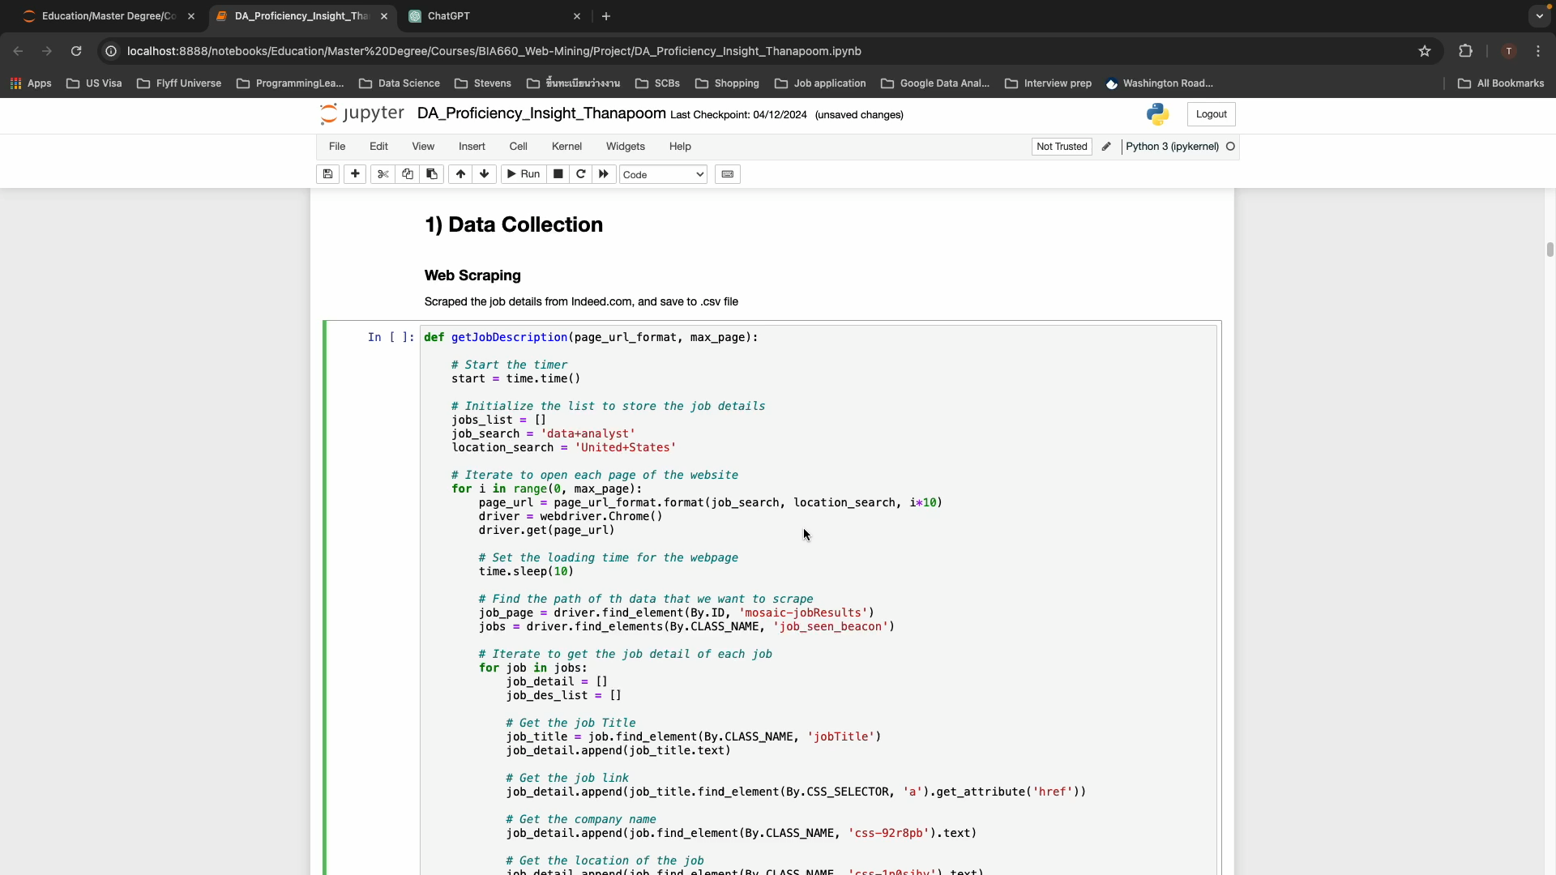
Overview
Dataset & Tools
Implementation
Results
Conclusion
1. Data Collection (Video Example)
Data Analyst Proficiency Insight: A Comprehensive Skills and Qualification Analysis

Slide 10
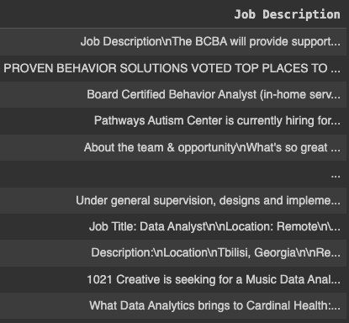
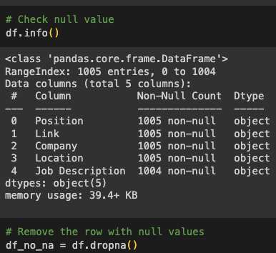
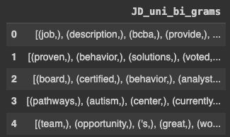
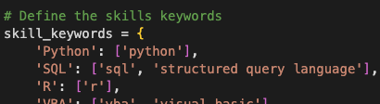
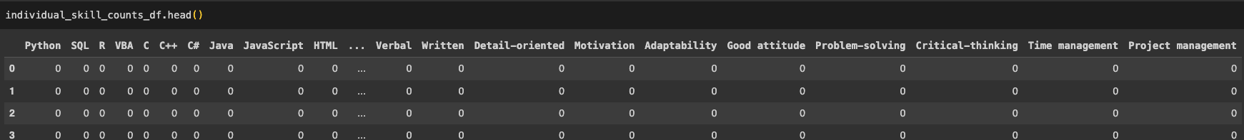
Overview
Dataset & Tools
Implementation
Results
Conclusion
2. Data Preparation
Remove 1 row that contains missing value
Tokenized and extracted text in each document to get Unigram and Bigrams
Detect skills from unigram and bigrams using predefined keywords, then count in the table
Define keywords of each skill that we interest
Create table for counting skills in jobs descriptions
Data Analyst Proficiency Insight: A Comprehensive Skills and Qualification Analysis

Slide 11
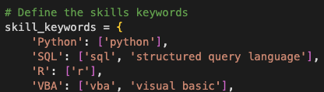
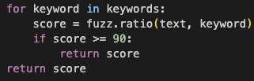
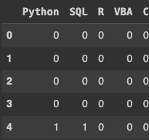
Overview
Dataset & Tools
Implementation
Results
Conclusion
3. Exploratory Data Analysis (Rule-based approach)
Change to the next word
Iterate to check each word in each document
Yes
Iterated over all the keywords or not?
No
Iterate to compare the word to each skill keyword
Not matched
Fuzzy matching
Match / Not match ?
Matched
Count in the table that the document requires matched skill
Data Analyst Proficiency Insight: A Comprehensive Skills and Qualification Analysis

Slide 12
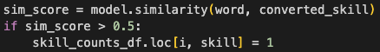
Overview
Dataset & Tools
Implementation
Results
Conclusion
3. Exploratory Data Analysis (Word-embeddings approach)
‘job’: [-1.45874023e-02, …],
‘description’: [-8.15429688e-02, …], …
Get the vector of each unique word
Change to the next word
Iterate to check each word in each document
Yes
Iterated over all the keywords or not?
No
Iterate to compare the word to each skill keyword
(Compare between vectors of word and keyword)
Not matched
Cosine similarity
Match / Not match?
Matched
Count in the table that the document requires matched skill
Data Analyst Proficiency Insight: A Comprehensive Skills and Qualification Analysis

Slide 13
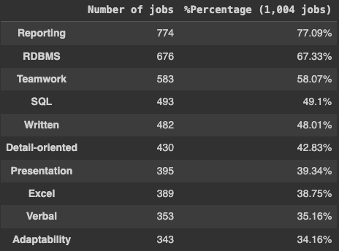
Overview
Dataset & Tools
Implementation
Results
Conclusion
3. Exploratory Data Analysis (Number of required skills)
Top 10 required skills from
Rule-based approach
Top 10 required skills from
Word-embeddings approach
Both approaches provided the same results
Data Analyst Proficiency Insight: A Comprehensive Skills and Qualification Analysis

Slide 14
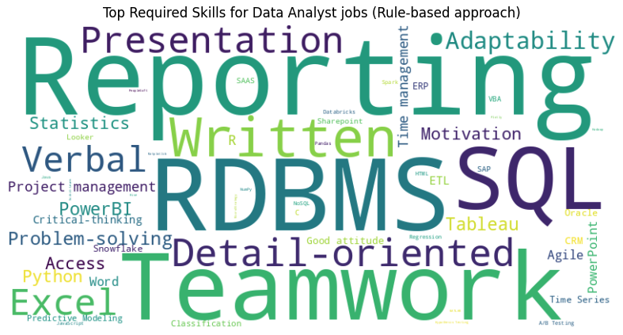
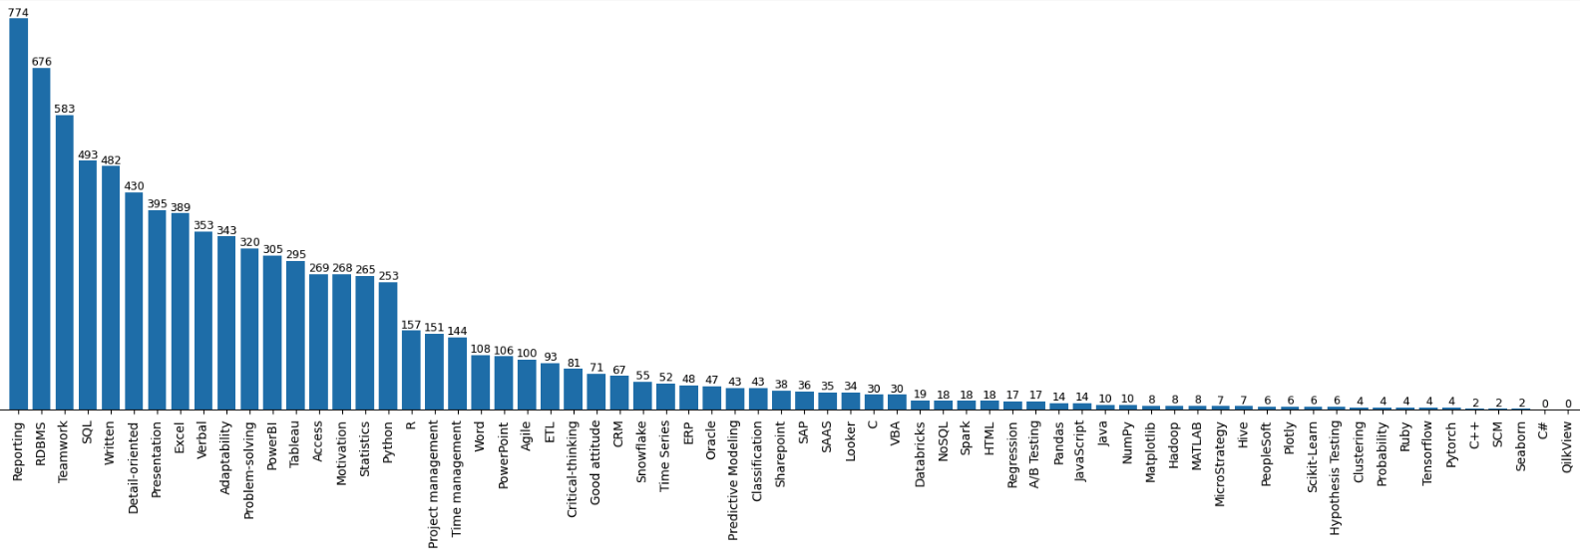
Overview
Dataset & Tools
Implementation
Results
Conclusion
3. Exploratory Data Analysis (Number of required skills)
Data Analyst Proficiency Insight: A Comprehensive Skills and Qualification Analysis

Slide 15
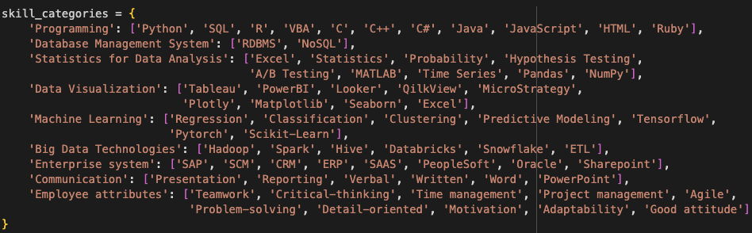
Overview
Dataset & Tools
Implementation
Results
Conclusion
4. Data Interpretation
Firstly, we categorized required skills into significant groups
Data Analyst Proficiency Insight: A Comprehensive Skills and Qualification Analysis

Slide 16
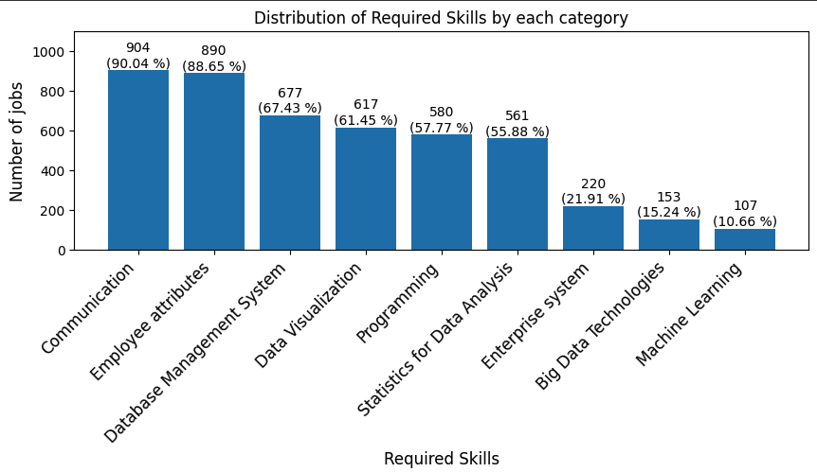
Overview
Dataset & Tools
Implementation
Results
Conclusion
4. Data Interpretation (Required skills by categories)
Data Analyst Proficiency Insight: A Comprehensive Skills and Qualification Analysis

Slide 17
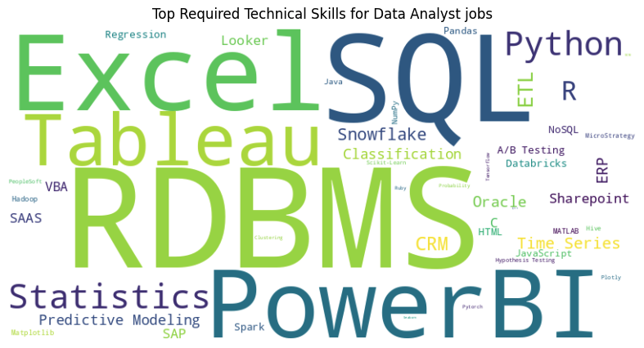
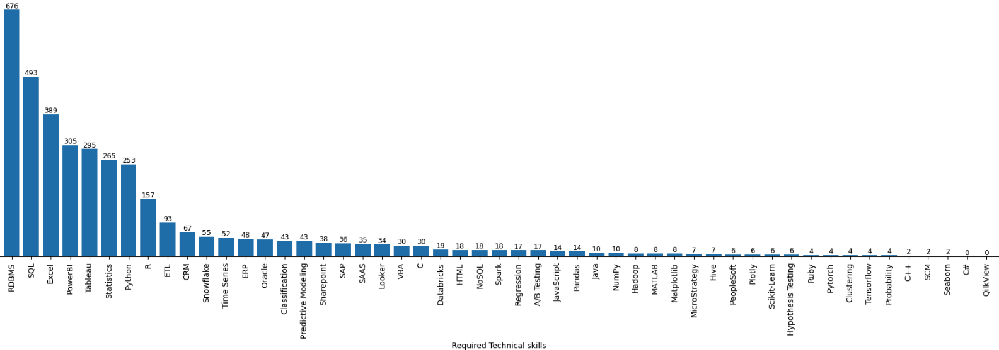
Overview
Dataset & Tools
Implementation
Results
Conclusion
4. Data Interpretation (Required Technical Skills)
Data Analyst Proficiency Insight: A Comprehensive Skills and Qualification Analysis

Slide 18
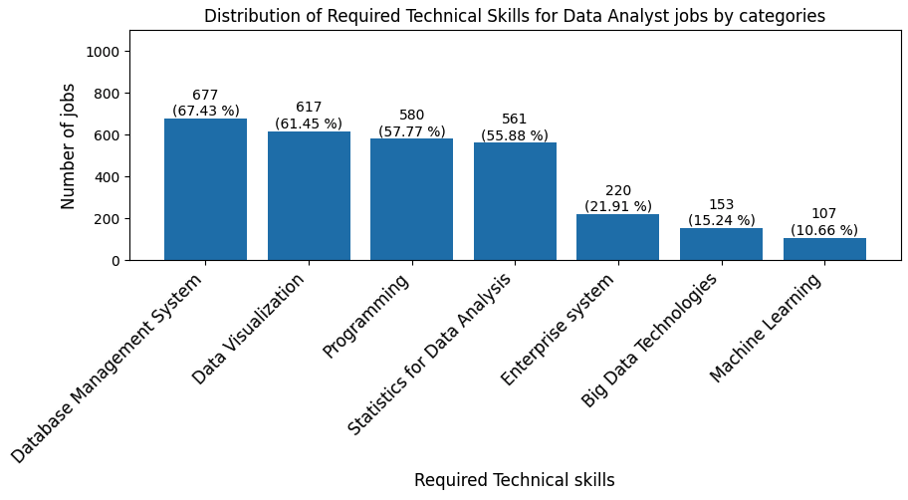
Overview
Dataset & Tools
Implementation
Results
Conclusion
4. Data Interpretation (Required Technical Skills by categories)
Data Analyst Proficiency Insight: A Comprehensive Skills and Qualification Analysis

Slide 19
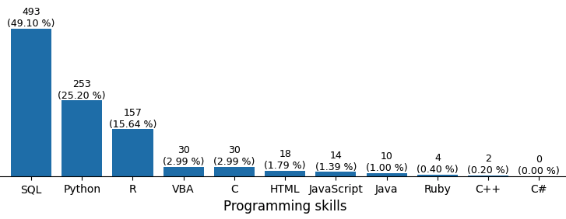
Overview
Dataset & Tools
Implementation
Results
Conclusion
4. Data Interpretation (Required Programming Skills)
Data Analyst Proficiency Insight: A Comprehensive Skills and Qualification Analysis

Slide 20
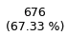
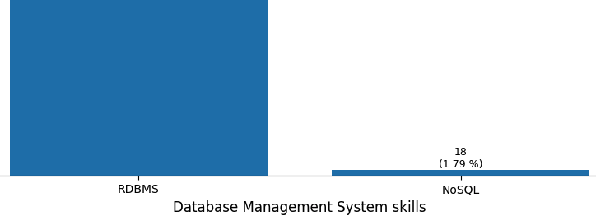
Overview
Dataset & Tools
Implementation
Results
Conclusion
4. Data Interpretation (Required Database Management System Skills)
Data Analyst Proficiency Insight: A Comprehensive Skills and Qualification Analysis

Slide 21
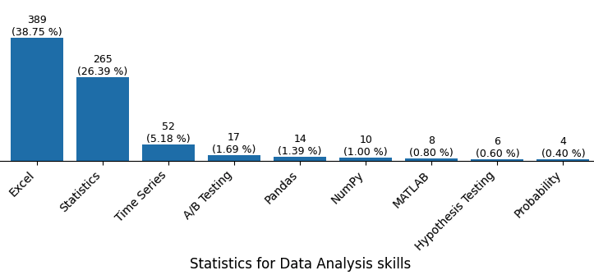
Overview
Dataset & Tools
Implementation
Results
Conclusion
4. Data Interpretation (Required Statistics for Data Analysis Skills)
Data Analyst Proficiency Insight: A Comprehensive Skills and Qualification Analysis

Slide 22
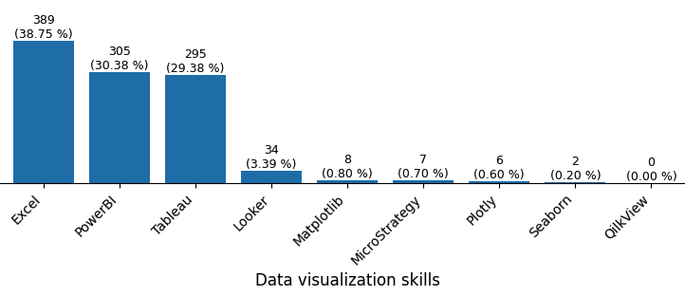
Overview
Dataset & Tools
Implementation
Results
Conclusion
4. Data Interpretation (Required Data Visualization Skills)
Data Analyst Proficiency Insight: A Comprehensive Skills and Qualification Analysis

Slide 23
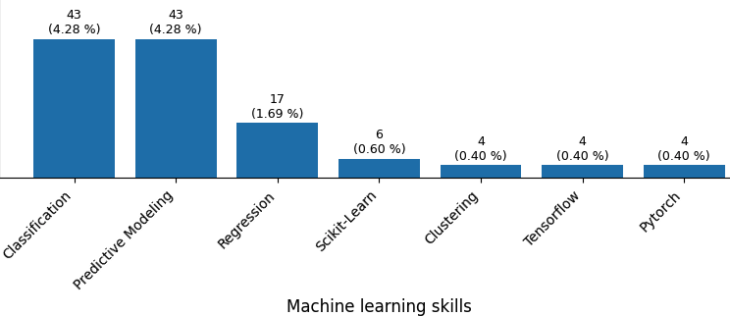
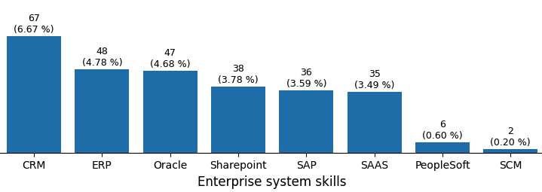
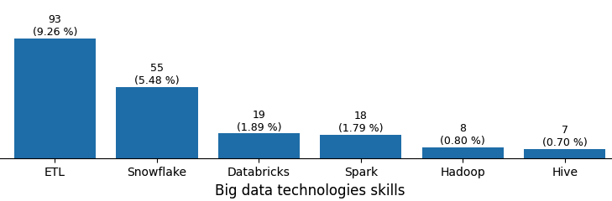
Overview
Dataset & Tools
Implementation
Results
Conclusion
4. Data Interpretation (Other required skills “Good to have”)
Data Analyst Proficiency Insight: A Comprehensive Skills and Qualification Analysis

Slide 24
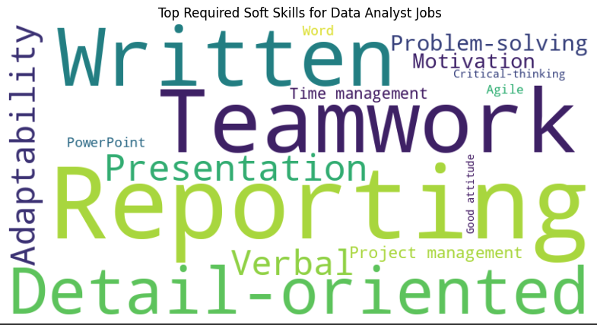
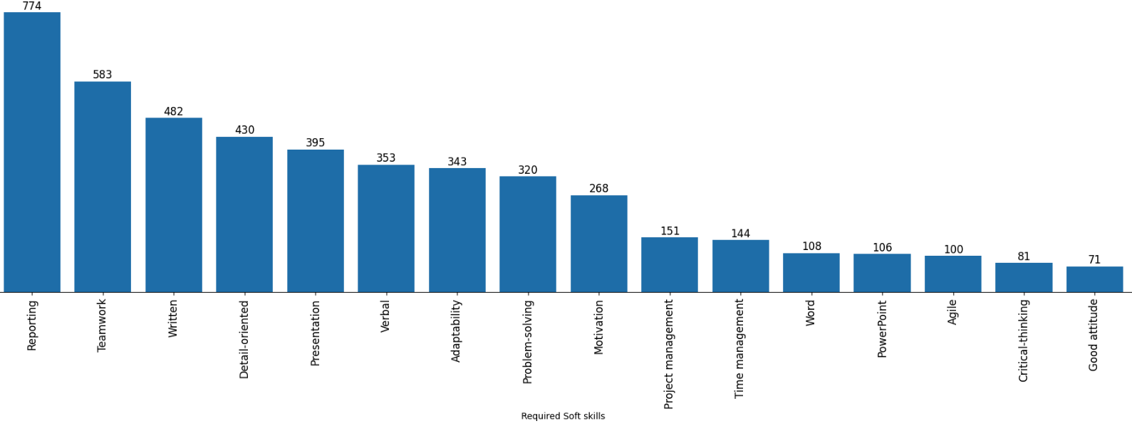
Overview
Dataset & Tools
Implementation
Results
Conclusion
4. Data Interpretation (Required Soft Skills)
Data Analyst Proficiency Insight: A Comprehensive Skills and Qualification Analysis

Slide 25
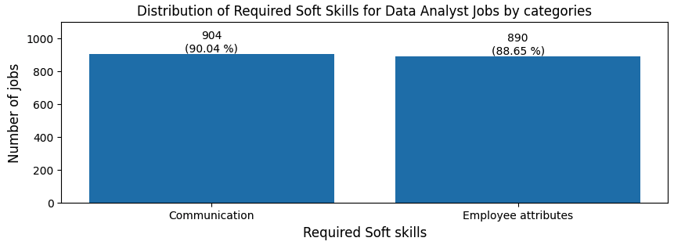
Overview
Dataset & Tools
Implementation
Results
Conclusion
4. Data Interpretation (Required Soft Skills by categories)
Data Analyst Proficiency Insight: A Comprehensive Skills and Qualification Analysis

Slide 26
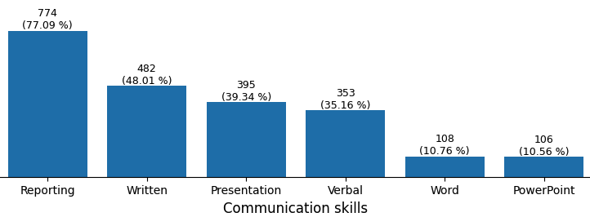
Overview
Dataset & Tools
Implementation
Results
Conclusion
4. Data Interpretation (Required Communication Skills)
Data Analyst Proficiency Insight: A Comprehensive Skills and Qualification Analysis

Slide 27
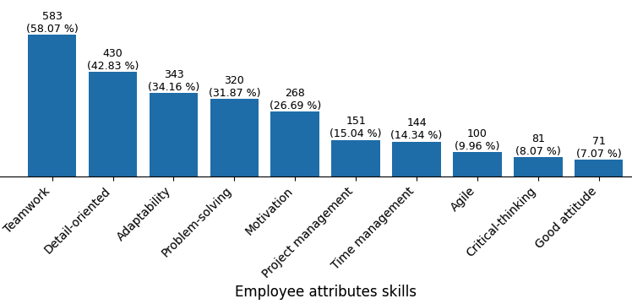
Overview
Dataset & Tools
Implementation
Results
Conclusion
4. Data Interpretation (Required Employee Attributes Skills)
Data Analyst Proficiency Insight: A Comprehensive Skills and Qualification Analysis

Slide 28
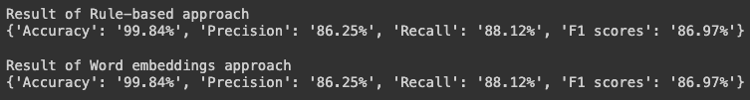
Overview
Dataset & Tools
Implementation
Results
Conclusion
Evaluation
I manually reviewed 200 job descriptions to collect the ground truth data for evaluating the performance of these 2 approaches by metrics including, Accuracy, Precision, Recall, and F1 scores.
Performance to detect skills
Running time of each approach
From the above results, we can see that both approaches provided the same performance to detect skills in job descriptions, but in term of running time, word-embeddings approach is much faster than rule-based approach.
Data Analyst Proficiency Insight: A Comprehensive Skills and Qualification Analysis

Slide 29
Overview
Dataset & Tools
Implementation
Results
Conclusion
5. Conclusion
The required skills (Mandatory) are Communication, Employee attributes, DBMS, Data Visualization, Programming, and Statistics for Data Analysis.
The good-to-have skills (Optional) are Enterprise system, Big Data Technologies, and Machine Learning.
Communication | Employee Attributes | Database Management System | Data Visualization | Programming | Statistics for Data Analysis
Reporting | Teamwork | RDBMS | Excel | SQL | Excel
Written | Detail-oriented |  | Power BI | Python | Statistics
Presentation | Adaptability |  | Tableau
Verbal | Problem-solving
 | Motivation
More than 25% of Data Analyst jobs required the above skills
Data Analyst Proficiency Insight: A Comprehensive Skills and Qualification Analysis

Slide 30
Overview
Dataset & Tools
Implementation
Results
Conclusion
5. Conclusion
Research questions (Answers)
What skills are most required for Data Analyst? - Reporting, Teamwork, RDBMS, SQL, Written
Which technical skills are most required for Data Analyst? - RDBMS, SQL, Excel, Power BI, Tableau, Statistics, Python
Which soft skills are most required for Data Analyst? - Reporting, Teamwork, Written, Detail-Oriented, Presentation
Which programming languages are most required for Data Analyst? - SQL, Python, R
Which skills are good to have for more opportunities? - Machine Learning (Classification, Predictive Modelling), Enterprise systems, Big Data Technologies
Data Analyst Proficiency Insight: A Comprehensive Skills and Qualification Analysis

Slide 31

Thank you
for your attention
Data Analyst Proficiency Insight: A Comprehensive Skills and Qualification Analysis

